Slide 1
NATURAL LANGUAGE PROCESSING
HOMEWORK – 6
By Ravinthiran Partheepan

Slide 2
Query
Try to think about the application fields of the sentiment analysis.
Analyze internet comments and detect sarcasm or threats. Try to think about the methods that could solve these types of problems.

Slide 3
Technical Aspects
Programming Language Used :- R Script
Package Used :- R <- “Sentimentr”

Slide 4
About the Package
sentimentr attempts to take into account valence shifters (i.e., negators, amplifiers (intensifiers), de-amplifiers (downtoners), and adversative conjunctions) while maintaining speed.
sentimentr is an augmented dictionary lookup.
Package Installation in R:- “ install.packages(‘sentimentr’)

Slide 5
Solution for the Query
I have created three variables named ‘Ravi’ ‘Suren’ ‘ravi_suren’.
In the ravi,suren,ravi_suren entities, I have assigned a string ‘I am a Good person’ %>% ravi <- c(‘I am a Good Person’), suren <- c(‘ I know my way out but i dont want your advice pal don’t be insane’); ravi_suren-<c(Bigil is a good film’)
By using sentimentr package i have extracted the sentiment_by words, Emotion_terms and Profanity_terms.
Sentiment_by <- Analyze the sentence whether it is postive or negative ratio. For eg: 0.3357(Pos+)
Emotion_terms <- Analyze the sentence with characteristics of words in a sentence(for eg:Joy,Fear,Anticipation,Element_id).

Slide 6
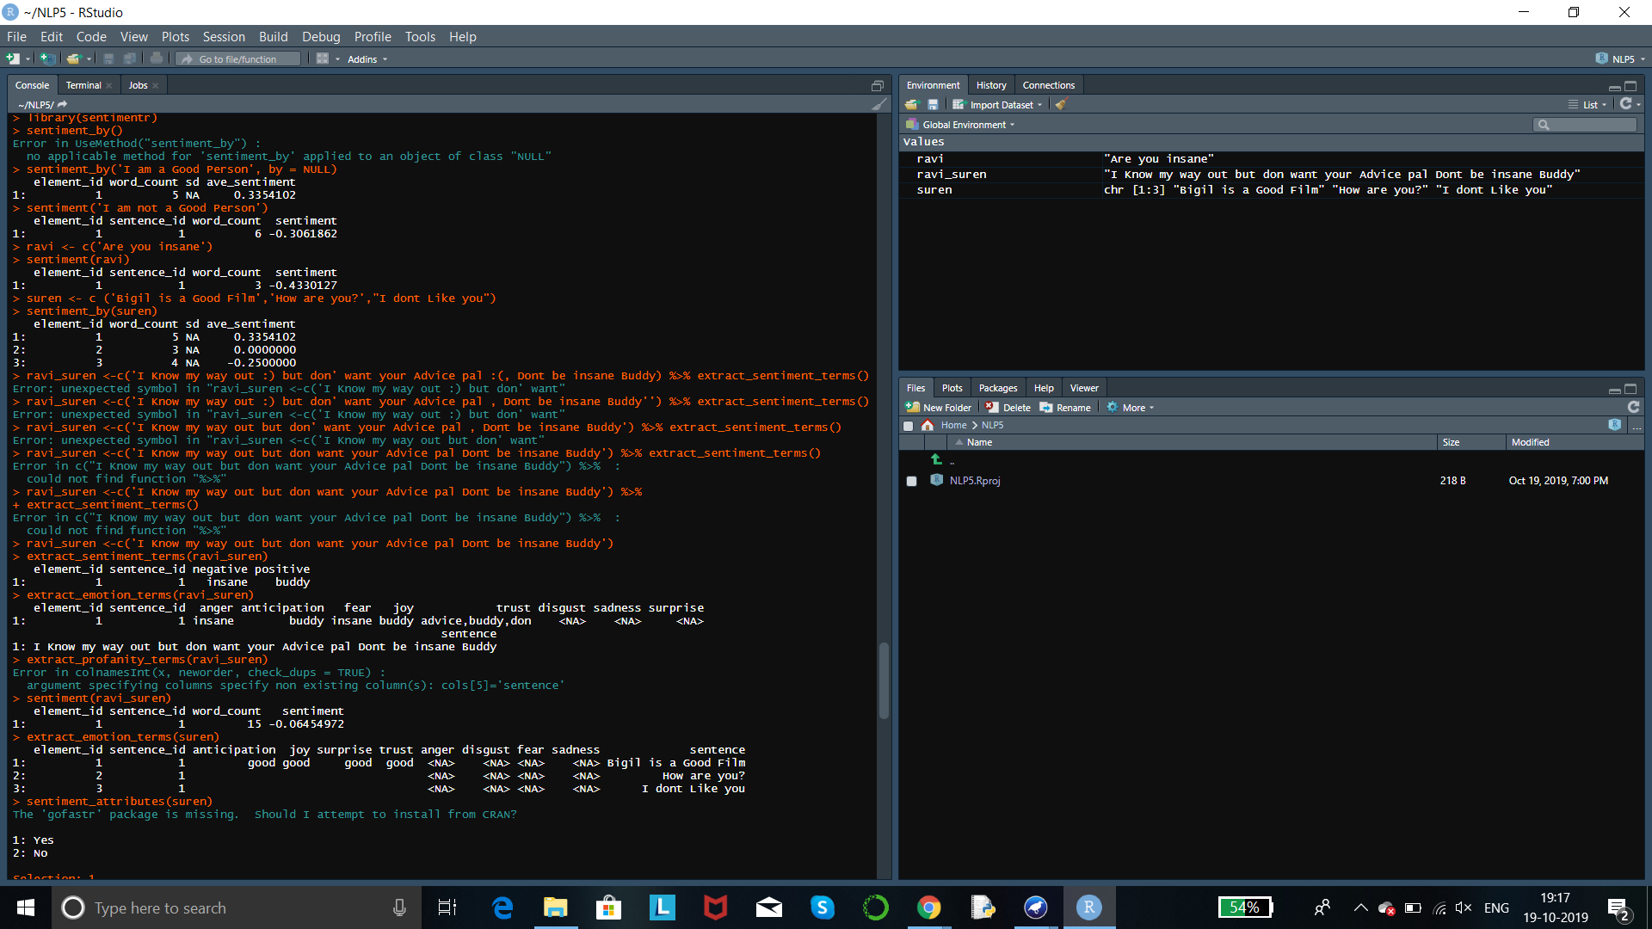
Program Code

Slide 7
Output

Slide 8
Output

Slide 9
Thank You!

